Slide 1

Web and Cloud Security
Department of Economic Informatics and Cybernetics
Bucharest University of Economic Studies
ASP.NET MVC Core – Part II
Liviu-Adrian Cotfas, PhD.
liviu.cotfas@ase.ro

Slide 2
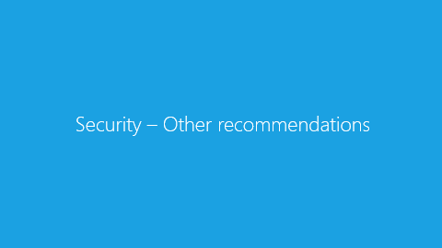
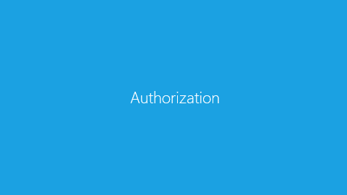
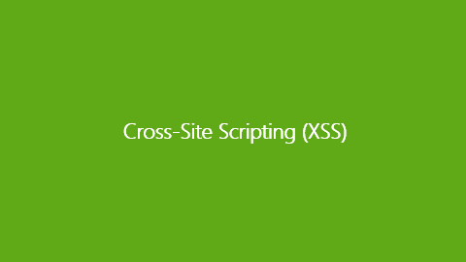
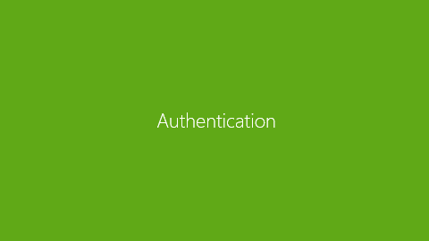
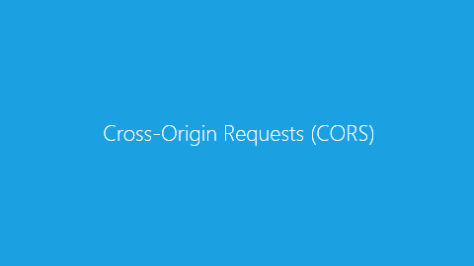
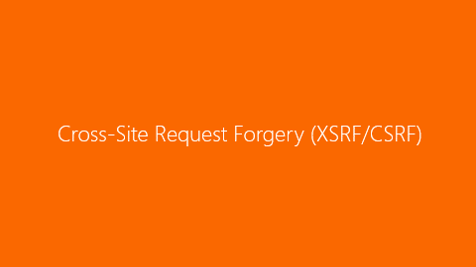
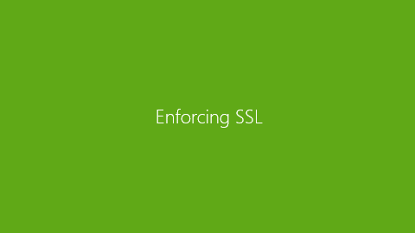
Contents

Slide 3

ASP.NET MVC Core, C# Language
url: https://docs.microsoft.com/en-us/aspnet/core
C#

Slide 4

About me
https://ro.linkedin.com/in/cotfasliviu

Slide 5

Administrative issues
Recommended Reading / Watching
Pro ASP.NET Core MVC
ADAM FREEMAN
Now in its 6th edition, the best selling book on MVC is now updated for ASP.NET Core MVC.
http://www.apress.com/us/book/9781484203989
https://github.com/apress/pro-asp.net-core-mvc

Slide 6
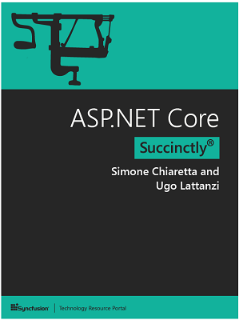
Administrative issues
Recommended Reading / Watching
ASP.NET Core Succinctly (Free)
Simone Chiaretta and Ugo Lattanzi
In ASP.NET Core Succinctly, seasoned authors Simone Chiaretta and Ugo Lattanzi update you on all the advances provided by Microsoft’s landmark framework.
https://www.syncfusion.com/resources/techportal/details/ebooks/ASP_NET_Core_Succinctly

Slide 7
Administrative issues
Further Reading / Watching
Courses on Microsoft Virtual Academy - mva.microsoft.com
Free
Courses on PluralSight - www.pluralsight.com
Free trial
Free access (limited period) through Microsoft DreamSpark

Slide 8
Administrative issues
API reference and Source code
Documentation:
https://docs.microsoft.com/en-us/aspnet/core/
API reference:
https://docs.microsoft.com/en-us/aspnet/core/api/
Source code:
https://github.com/aspnet/Home
Various samples:
https://code.msdn.microsoft.com/

Slide 9
Authentication

Slide 10
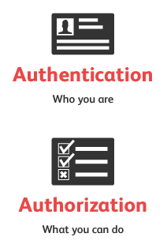
Authentication
Authentication - determining the identity of a user.
Authorization - determining whether a user is allowed to perform an action

Slide 11
Authentication
ASP.NET Core Identity
ASP.NET Core Identity is an API from Microsoft to manage users in ASP.NET applications
Users can create an account and login with their Active Directory account, with a user name and password or they can use an external login providers such as Facebook, Google, Microsoft Account, Twitter and more
ASP.NET Core Identity can be configured to use a SQL Server database to store user names, passwords, and profile data. Alternatively, you can use your own persistent store to store data in another persistent storage, such as Azure Table Storage
OSS alternatives are also available: link

Slide 12
Authentication
ASP.NET Core Identity
Why is it useful?
User management is an important feature for most applications, and ASP.NET Core Identity provides a ready-made and well-tested platform that doesn’t require you to create custom versions of commonly demanded functions.
NuGet Package:
Microsoft.AspNetCore.Identity.EntityFrameworkCore
Documentation: link

Slide 13
Authentication
IdentityUser Class
AccessFailedCount | Gets or sets the number of failures for the purposes of lockout.(Inherited from IdentityUser(Of TKey, TLogin, TRole, TClaim).)
Email | Gets or sets the email for the user.(Inherited from IdentityUser(Of TKey, TLogin, TRole, TClaim).)
EmailConfirmed | Gets or sets a value that indicates whether the email is confirmed.(Inherited from IdentityUser(Of TKey, TLogin, TRole, TClaim).)
Id | Gets or sets the user identifier.(Inherited from IdentityUser(Of TKey, TLogin, TRole, TClaim).)
LockoutEnabled | Gets or sets a value that indicates whether lockout enabled for this user.(Inherited from IdentityUser(Of TKey, TLogin, TRole, TClaim).)
LockoutEndDateUtc | Gets or sets the date time value (in UTC) when lockout ends, any time in the past is considered not locked out.(Inherited from IdentityUser(Of TKey, TLogin, TRole, TClaim).)
Logins | Gets the collection of logins for the user.(Inherited from IdentityUser(Of TKey, TLogin, TRole, TClaim).)

Slide 14
Authentication
IdentityUser Class
PasswordHash | Gets or sets the salted/hashed form of the user password.(Inherited from IdentityUser(Of TKey, TLogin, TRole, TClaim).)
PhoneNumber | Gets or sets the phone number for the user.(Inherited from IdentityUser(Of TKey, TLogin, TRole, TClaim).)
PhoneNumberConfirmed | Gets or sets the value that indicates whether the phone number is confirmed. The default is false.(Inherited from IdentityUser(Of TKey, TLogin, TRole, TClaim).)
Roles | Gets the collection of roles for the user.(Inherited from IdentityUser(Of TKey, TLogin, TRole, TClaim).)
SecurityStamp | Gets or sets a random value that changes when a user’s credentials change.(Inherited from IdentityUser(Of TKey, TLogin, TRole, TClaim).)
TwoFactorEnabled | Gets or sets a value that indicates whether two-factor authentication is enabled for the user.(Inherited from IdentityUser(Of TKey, TLogin, TRole, TClaim).)
UserName | Gets or sets the user name.(Inherited from IdentityUser(Of TKey, TLogin, TRole, TClaim).)

Slide 15
Authentication
ASP.NET Core Identity
The identity services should be added to the application in the ConfigureServices method in the Startup class:
public void ConfigureServices(IServiceCollection services)
{
services.AddDbContext<ApplicationDbContext>(options =>
options.UseSqlServer(
Configuration["Data:Database:ConnectionString"]));
services.AddTransient<IProductRepository, EFProductRepository>();
services.AddIdentity<IdentityUser, IdentityRole>()
.AddEntityFrameworkStores<ApplicationDbContext>();
services.AddMvc();
}

Slide 16
Authentication
Configure Identity
Password policy:
User's lockout:
options.Password.RequireDigit = true;
options.Password.RequiredLength = 8;
options.Password.RequireNonAlphanumeric = false;
options.Password.RequireUppercase = true;
options.Password.RequireLowercase = false;
// Lockout settings
options.Lockout.DefaultLockoutTimeSpan = TimeSpan.FromMinutes(30);
options.Lockout.MaxFailedAccessAttempts = 10;
options.Lockout.AllowedForNewUsers = true;

Slide 17
Authentication
Configure Identity
Application's cookie settings:
// Cookie settings
options.Cookies.ApplicationCookie.CookieName = "YouAppCookieName";
options.Cookies.ApplicationCookie.ExpireTimeSpan = TimeSpan.FromDays(150);
options.Cookies.ApplicationCookie.LoginPath = "/Account/LogIn";
options.Cookies.ApplicationCookie.LogoutPath = "/Account/LogOff";
options.Cookies.ApplicationCookie.AccessDeniedPath = "/Account/AccessDenied";
options.Cookies.ApplicationCookie.AutomaticAuthenticate = true;
options.Cookies.ApplicationCookie.AuthenticationScheme = Microsoft.AspNetCore.Authentication.Cookies.CookieAuthenticationDefaults.AuthenticationScheme;
options.Cookies.ApplicationCookie.ReturnUrlParameter = Microsoft.AspNetCore.Authentication.Cookies.CookieAuthenticationDefaults.ReturnUrlParameter;

Slide 18

Authentication
Authentication using Facebook, Google
Enabling users to sign in with their existing credentials is convenient for the users and shifts many of the complexities of managing the sign-in process onto a third party.
How to implement: link
Introduction to OAuth 2: link

Slide 19

Authentication
Demo
https://github.com/liviucotfas/ase-web-and-cloud-applications-security/blob/master/6%20-%20MVCStore%20-%20Security.md

Slide 20
Authentication
Recommended reading
https://github.com/liviucotfas/ase-web-and-cloud-applications-security/raw/master/book/12%20-%20SportsStore%20-%20Security.pdf
Configure Identity primary keys data type: link
Two-factor authentication with SMS: link
Azure Active Directory: link

Slide 21
Authorization

Slide 22
Authorization
Authorization - determining whether a user is allowed to perform an action
Example: an administrative user is allowed to create a document library, add documents, edit documents, and delete them. A non-administrative user working with the library is only authorized to read the documents.
Authorization is orthogonal and independent from authentication, which is the process of ascertaining who a user is. Authentication may create one or more identities for the current user.
Notes:
References:
https://docs.microsoft.com/en-us/aspnet/core/security/authorization/introduction

Slide 23
Authorization
ASP.NET Core authorization provides a simple declarative role and a policy based model.
Authorization is expressed in requirements, and handlers evaluate a user's claims against requirements. Imperative checks can be based on simple policies or policies which evaluate both the user identity and properties of the resource that the user is attempting to access.
Namespace: Microsoft.AspNetCore.Authorization
Further reading: link
Notes:
References:
https://docs.microsoft.com/en-us/aspnet/core/security/authorization/introduction

Slide 24
Authorization
[Authorize]
[AuthorizeAttribute]
tells MVC that only requests from authenticated users should be processed
properties: Roles, Users
can be applied both at action and at controller level
The ASP.NET platform provides information about the user through the HttpContext object, which is used by the Authorize attribute to check the status of the current request and see whether the user has been authenticated. The HttpContext.User property returns an implementation of the IPrincipal interface, which is defined in the System.Security.Principal namespace.

Slide 25
Authorization
[Authorize]
action level
controller level
public class HomeController : Controller {
[Authorize]
public ViewResult Index(){
return View();
}
}
[Authorize]
public class HomeController : Controller {
public ViewResult Index(){
return View();
}
}

Slide 26
Authorization
[Authorize]
Imperative
Declarative (recommended)
public ActionResult Details(int id)
{
if (!User.IsInRole("EmployeeViewer"))
return new HttpUnauthorizedResult();
// Action logic
}
[Authorize(Roles = "EmployeeViewer")]
public ActionResult Details(int id)
{
// Action logic
}

Slide 27
Authorization
Security Attributes
[AllowAnonymous]
Specifies that actions and controllers are skipped by AuthorizeAttribute during authorization.
Example: the login action
[Authorize]
public class AccountController : Controller {
[AllowAnonymous]
public IActionResult Login() {
return View();
}
[HttpPost]
[AllowAnonymous]
[ValidateAntiForgeryToken]
public async Task<IActionResult> Login(LoginModel details) {
return View(details);
}
}

Slide 28
Enforcing SSL
Notes:
https://docs.microsoft.com/en-us/aspnet/core/security/enforcing-ssl

Slide 29
Authorization
Enforcing SSL
[RequireHttpsAttribute]
can be used to decorate controllers or actions;
Can also be configured globally:
Note: The highlighted code above requires all requests to use HTTPS, therefore HTTP requests are ignored.
// Requires using Microsoft.AspNetCore.Mvc;
public void ConfigureServices(IServiceCollection services){
services.Configure<MvcOptions>(options =>
{
options.Filters.Add(new RequireHttpsAttribute());
});

Slide 30
Authorization
Enforcing SSL
Redirects all HTTP requests to HTTPS:
Further reading: link
// Requires using Microsoft.AspNetCore.Rewrite;
public void Configure(IApplicationBuilder app, IHostingEnvironment env, ILoggerFactory loggerFactory)
{
var options = new RewriteOptions().AddRedirectToHttps();
app.UseRewriter(options);

Slide 31
Cross-Site Request Forgery (XSRF/CSRF)

Slide 32
Cross-Site Request Forgery (XSRF/CSRF)
Cross-site request forgery (also known as XSRF or CSRF, pronounced see-surf) is an attack against web-hosted applications whereby a malicious web site can influence the interaction between a client browser and a web site that trusts that browser.
These attacks are made possible because web browsers send some types of authentication tokens automatically with every request to a web site. This form of exploit is also known as a one-click attack or as session riding, because the attack takes advantage of the user's previously authenticated session.
A malicious site sends POST/GET requests to the attacked site (in which the user is authenticated).
Notes:
https://docs.microsoft.com/en-us/aspnet/core/security/anti-request-forgery

Slide 33
Cross-Site Request Forgery (XSRF/CSRF)
An example of a CSRF attack
A user logs into www.example.com, using forms authentication.
The server authenticates the user and issues a response that includes an authentication cookie.
The user visits a malicious site.
This malicious site contains the following HTML form:
Note: the form action posts to the vulnerable site, not to the malicious site. This is the “cross-site” part of CSRF.
<h1>You Are a Winner!</h1>
<form action="http://example.com/api/account" method="post">
<input type="hidden" name="Transaction" value="withdraw" />
<input type="hidden" name="Amount" value="1000000" />
<input type="submit" value="Click Me"/>
</form>
Notes:
https://docs.microsoft.com/en-us/aspnet/core/security/anti-request-forgery

Slide 34
Cross-Site Request Forgery (XSRF/CSRF)
An example of a CSRF attack
The user clicks the submit button. The browser automatically includes the authentication cookie for the requested domain (the vulnerable site in this case) with the request.
The request runs on the server with the user’s authentication context, and can do anything that an authenticated user is allowed to do.
Although this example requires the user to click the form button, the malicious page could just as easily run a script that automatically submits the form or sends a form submission as an AJAX request. The form could also be hidden using CSS so the user never realizes it's present. Moreover, using SSL does not prevent a CSRF attack, because the malicious site can send an https:// request. Some attacks can target site endpoints that respond to GET requests, in which case even an image tag can be used to perform the action.
Notes:
https://docs.microsoft.com/en-us/aspnet/core/security/anti-request-forgery

Slide 35
Cross-Site Request Forgery (XSRF/CSRF)
An example of a CSRF attack
Typically, CSRF attacks are possible against web sites that use cookies for authentication, because browsers send all relevant cookies to the destination web site.
However, CSRF attacks are not limited to exploiting cookies. For example, Basic and Digest authentication are also vulnerable. After a user logs in with Basic or Digest authentication, the browser automatically sends the credentials until the session ends.
Users can guard against CSRF vulnerabilities by:
Logging off of web sites when they have finished using them
Clearing their browser's cookies periodically
Notes:
https://docs.microsoft.com/en-us/aspnet/core/security/anti-request-forgery

Slide 36
Cross-Site Request forgery
How does ASP.NET Core MVC address CSRF?
The most common approach to defending against CSRF attacks is the synchronizer token pattern (STP).
STP is a technique used when the user requests a page with form data. The server sends a token associated with the current user's identity to the client.
The client must send back the token to the server for verification. If the server receives a token that doesn't match the authenticated user's identity, the request should be rejected.
The token is unique and unpredictable. The token can also be used to ensure proper sequencing of a series of requests (ensuring page 1 precedes page 2 which precedes page 3).
Notes:
https://docs.microsoft.com/en-us/aspnet/core/security/anti-request-forgery

Slide 37
Cross-Site Request forgery
How does ASP.NET Core MVC address CSRF?
ASP.NET Core MVC will generate Antiforgery Tokens by default on all forms it generates:
<form asp-controller="Manage" asp-action="ChangePassword" method="post">
</form>
@using (Html.BeginForm("ChangePassword", "Manage"))
{
}
Notes:
https://docs.microsoft.com/en-us/aspnet/core/security/anti-request-forgery

Slide 38
Cross-Site Request forgery
How does ASP.NET Core MVC address CSRF?
You can also explicitly add an antiforgery token to a <form> element you create without using tag helpers or HTML helpers by using @Html.AntiForgeryToken():
In each of the above cases, ASP.NET Core will add a hidden form field like the following:
<form action="/" method="post">
@Html.AntiForgeryToken()
</form>
<input name="__RequestVerificationToken" type="hidden" value="CfDJ8NrAkSldwD9CpLRyOtm6FiJB1Jr_F3FQJQDvhlHoLNJJrLA6zaMUmhjMsisu2D2tFkAiYgyWQawJk9vNm36sYP1esHOtamBEPvSk1_x--Sg8Ey2a-d9CV2zHVWIN9MVhvKHOSyKqdZFlYDVd69XYx-rOWPw3ilHGLN6K0Km-1p83jZzF0E4WU5OGg5ns2-m9Yw" />
Notes:
https://docs.microsoft.com/en-us/aspnet/core/security/anti-request-forgery

Slide 39
Cross-Site Request forgery
How does ASP.NET Core MVC address CSRF?
[ValidateAntiForgeryToken]
action filter that can be applied to an individual action, a controller, or globally for the app. Requests made to actions that have this filter applied will be blocked unless the request includes a valid antiforgery token.
[Authorize]
public class AccountController : Controller {
[HttpPost]
[AllowAnonymous]
[ValidateAntiForgeryToken]
public async Task<IActionResult> Login(LoginModel details) {
return View(details);
}
}
Notes:
https://docs.microsoft.com/en-us/aspnet/core/security/anti-request-forgery

Slide 40
Cross-Site Request forgery
Demo

Slide 41
Cross-Site Request forgery
How does ASP.NET Core MVC address CSRF?
[IgnoreAntiforgeryToken]
used to eliminate the need for an antiforgery token to be present for a given action (or controller). The filter will override ValidateAntiForgeryToken and/or AutoValidateAntiforgeryToken filters specified at a higher level (globally or on a controller).
[Authorize]
[AutoValidateAntiforgeryToken]
public class ManageController : Controller{
[HttpPost]
[IgnoreAntiforgeryToken]
public async Task<IActionResult> DoSomethingSafe(SomeViewModel model){
// no antiforgery token required
}
}

Slide 42
Cross-Site Request forgery
How does ASP.NET Core MVC address CSRF?
[AutoValidateAntiforgeryToken]
in most cases, your application will not receive antiforgery tokens for certain kinds of HTTP requests, such as GET requests. Instead of broadly applying the ValidateAntiForgeryToken attribute and then overriding it with IgnoreAntiforgeryToken attributes, you can use the AutoValidateAntiforgeryToken attribute.
This attribute works identically to the ValidateAntiForgeryToken attribute, except that it doesn't require tokens for requests made using the following HTTP methods: GET, HEAD, OPTIONS, TRACE
The previously mentioned HTTP verbs should not change the data in your application anyway

Slide 43
Cross-Site Request forgery
How does ASP.NET Core MVC address CSRF?
JavaScript, AJAX, and SPAs (including Angular): link
Further reading: https://docs.microsoft.com/en-us/aspnet/core/security/anti-request-forgery
Further reading: https://docs.microsoft.com/en-us/aspnet/mvc/overview/security/xsrfcsrf-prevention-in-aspnet-mvc-and-web-pages
Notes:
https://docs.microsoft.com/en-us/aspnet/core/security/anti-request-forgery

Slide 44
Cross-Origin Requests (CORS)

Slide 45
Cross-Origin Requests (CORS)
Browser security prevents a web page from making AJAX requests to another domain. This restriction is called the same-origin policy, and prevents a malicious site from reading sensitive data from another site. However, sometimes you might want to let other sites make cross-origin requests to your web API.
Cross Origin Resource Sharing (CORS) is a W3C standard that allows a server to relax the same-origin policy. Using CORS, a server can explicitly allow some cross-origin requests while rejecting others. CORS is safer and more flexible than earlier techniques such as JSONP.
Further reading: link

Slide 46
Cross-Site Scripting (XSS)

Slide 47
Cross-Site Scripting (XSS)
Cross-Site Scripting (XSS) is a security vulnerability which enables an attacker to place client side scripts (usually JavaScript) into web pages. When other users load affected pages the attackers scripts will run, enabling the attacher to steal cookies and session tokens, change the contents of the web page through DOM manipulation or redirect the browser to another page.
XSS vulnerabilities generally occur when an application takes user input and outputs it in a page without validating, encoding or escaping it.
Further reading: link

Slide 48
Security – Other recommendations

Slide 49
General recommendations
Only Action methods should be public in controller classes. The [NonAction] attribute can also be used to hide public methods.
Implicit model binding can be used by attackers to modify unintended data.

Slide 50
Thank you!

